Slide 1
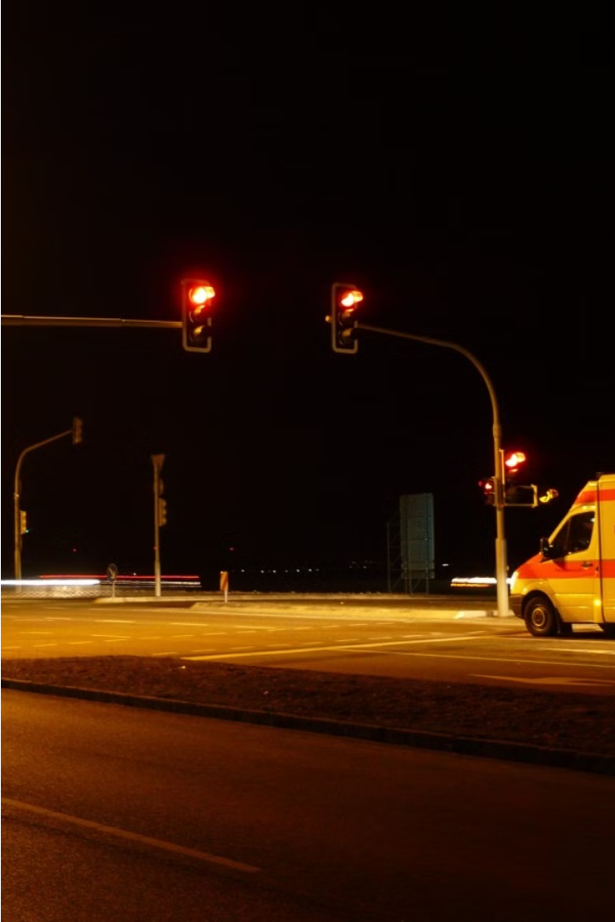

Green Corridors - Ambulance Detection System
In this innovative IoT project, we aim to automate traffic signals using advanced sound detection technology. By monitoring for the distinct sounds of approaching ambulances, our system can intelligently adjust the traffic lights, ensuring emergency vehicles have clear passage while maintaining efficient traffic flow.
by AARON JOEL, ABESHEK SRIKANTH, ANIRUDH G

Slide 2
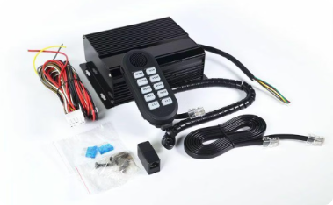
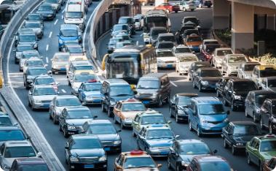
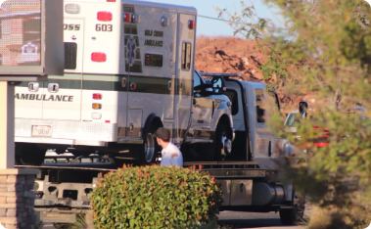
Problem Statement: Automating traffic signals for ambulances
Streamlining Emergency Response
Addressing Traffic Congestion
Enabling Unimpeded Passage
Heavy traffic and gridlock often prevent ambulances from passing through intersections efficiently. An automated system that can detect ambulance sirens and immediately clear the path can alleviate this critical problem.
By automatically turning the traffic signals green for the lane the ambulance is in and red for all other lanes, the IOT-based system can ensure the emergency vehicle has a clear, unobstructed path to its destination.
Ambulances face significant challenges navigating busy traffic to reach their destinations quickly. Automating traffic signals to prioritize ambulance routes can dramatically improve emergency response times and save lives.

Slide 3

ABSTRACT
The "Green Corridors" project automates traffic signals using sound detection to prioritize ambulances, turning relevant lights green. Utilizing Arduino, sensors, and LEDs, the system ensures rapid, clear passage for emergency vehicles. It offers a cost-effective, scalable solution to improve urban traffic management and emergency response times.

Slide 4

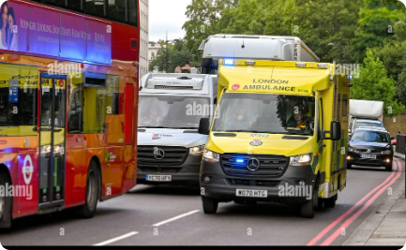
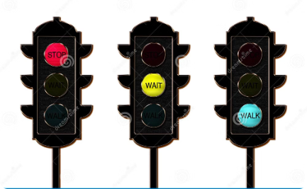
EXISTING SYSTEM
Optical Detection Systems:
Preemptive Traffic Signal Systems
Manual Traffic Control
These systems utilize optical sensors or infrared communication to detect emergency vehicles equipped with compatible transmitters.
These systems use GPS and radio signals to detect emergency vehicles and change traffic signals accordingly
In some cities, traffic officers manually control intersections during emergencies by physically stopping traffic and allowing emergency vehicles to pass

Slide 5

PROPOSED SYSTEM
The proposed "Green Corridors" system automates traffic signals using sound detection technology to respond to ambulance sirens in real-time. This system utilizes an Arduino Uno R3 microcontroller, a sound detection sensor, a buzzer, and LEDs. Upon detecting an ambulance siren, the sound sensor signals the Arduino, which then changes the traffic lights to green for the ambulance's lane and red for other lanes. After the ambulance passes, the signals revert to their normal state. This cost-effective and efficient solution ensures quick and unobstructed passage for emergency vehicles, reducing response times and improving overall traffic management.

Slide 6
Key Components
1
Arduino Uno R3
2
Sound Detection Sensor
The Arduino Uno R3 is the microcontroller board that will serve as the brain of the IOT-based automated traffic system.
A sensitive sound detection sensor will be used to pick up the distinct siren sounds of approaching ambulances.
3
Buzzer
4
LEDs
A buzzer will be integrated to provide audible alerts when the system detects an ambulance and activates the traffic signal changes.
LED lights will be used to visually indicate the state of the traffic signals - green for the ambulance lane, red for other lanes.

Slide 7
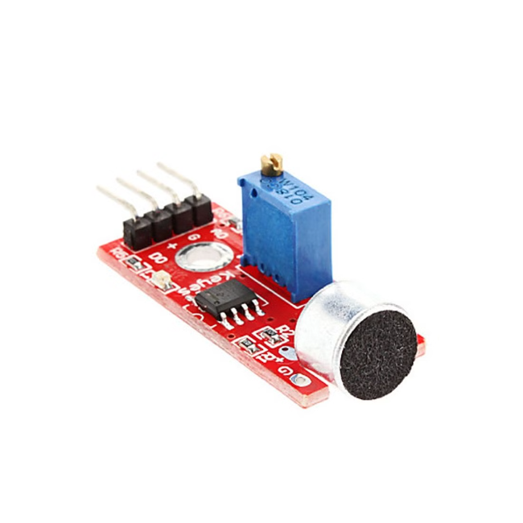
Sound Detection Mechanism
The IOT-based traffic signal automation system uses a high-sensitivity sound detection sensor to identify the distinct sound signature of an approaching ambulance siren. The sensor is strategically placed near the traffic intersection to continuously monitor the audio environment.
When the sensor detects the unique frequency and volume of the ambulance siren, it sends a signal to the connected Arduino Uno R3 microcontroller to trigger the automated traffic signal response.

Slide 8




Ambulance Sound Detection
Sound Sensing
1
Detect incoming siren sounds using a sensitive microphone.
Frequency Analysis
2
Identify distinct siren frequencies.
Signal Matching
3
Compare to known ambulance siren patterns.
Verification
4
Confirm detection using multiple sensors.
The algorithm detects, analyzes, matches, and verifies siren sounds to trigger traffic signal automation.

Slide 9
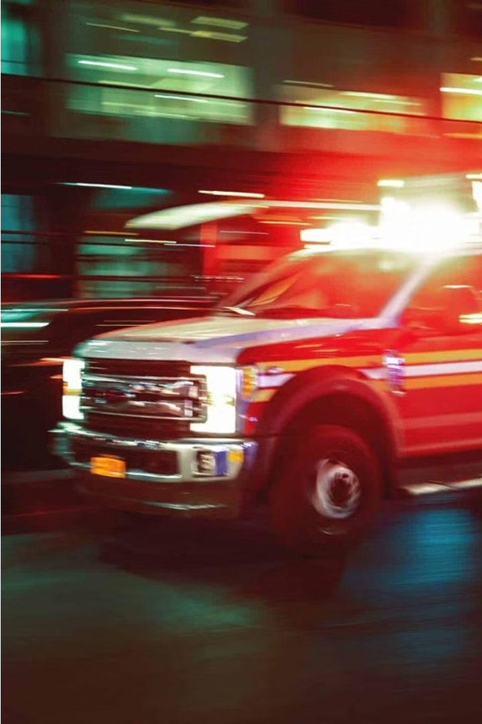
Green Light for Ambulance Lane
When the sound detection sensor identifies the distinct siren of an approaching ambulance, the system immediately triggers the traffic signals to turn green in the lane designated for the ambulance. This allows the emergency vehicle to quickly and safely pass through the intersection without any delays.

Slide 10

Red Light for Other Lanes
When the sound detection sensor picks up the distinctive siren of an approaching ambulance, the system immediately triggers the traffic signals in the ambulance's lane to turn green. Simultaneously, the signals in all other lanes turn red, ensuring a clear path for the emergency vehicle.
This rapid response allows the ambulance to swiftly navigate through the intersection, minimizing delays and improving emergency response times. The red signals in the other lanes prevent other vehicles from entering the intersection and potentially colliding with the ambulance.

Slide 11
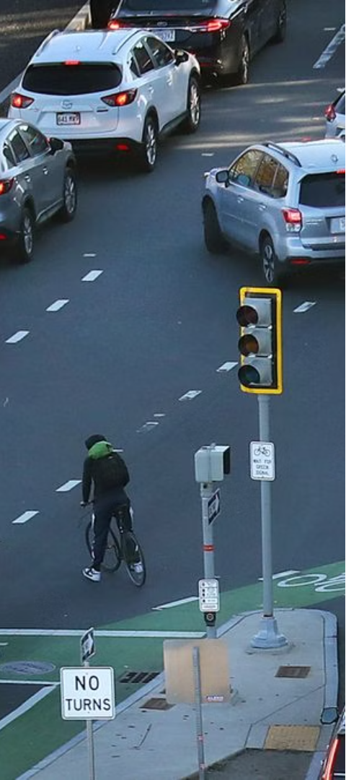

Restoring Normal Traffic Signal Operation
1
Signal Reset
Once the ambulance has safely passed, the traffic signals are automatically reset to their normal state.
2
Gradual Transition
The green light for the ambulance lane transitions back to a red light, while the other lanes gradually return to their normal signal patterns.
3
Smooth Flow Restoration
This seamless transition ensures that the flow of regular traffic is restored without any abrupt changes or disruptions.

Slide 12
Benefits of the IOT-based Automated Traffic System
Improved Emergency Response
Reduced Traffic Congestion
By optimizing traffic signal timing based on real-time conditions, the system can help alleviate bottlenecks and improve overall traffic flow.
The system automatically clears the way for ambulances, fire trucks, and other emergency vehicles, reducing response times and potentially saving lives.
Increased Safety
Environmental Benefits
The automated system reduces the risk of accidents by ensuring drivers are aware of emergency vehicles and can safely yield the right-of-way.
Smoother traffic flow and reduced idling times can lead to lower fuel consumption and emissions, benefiting the environment.

Slide 13

Conclusion and Future Enhancements
In conclusion, this IoT-based automated traffic system provides a smart and efficient solution for managing emergency vehicle traffic. Looking ahead, future enhancements could include integrating real-time traffic data and expanding the system to handle multiple emergency vehicle types.

